Slide 1

HPV genotyping is as important as cytology in anal cancer early diagnosis
Digaetano margherita, md
Policlinico di Modena, italy

Slide 2
Disclosures
I have no conflicts of interest

Slide 3
Squamous cell carcinoma of the anus in PLWH
The prevalence of this anal cancer among MSM PLWH is higher than in general population (131/100.000 vs 1/100.000)¹.
SCCA pathogenesis depends on the presence of an HPV infection.
HPV is also one of the most widespread sexually transmitted infection².
PLWH often house HPV-16 and HPV-18, genotypes with a high risk of oncogenic transformation (HRHPV), responsible together for approximately 85% of all SCCAs³.
Invasive carcinoma is generally preceded by low- or high-grade intraepithelial lesions⁴.
¹Shiels MS, Cole SR, Kirk GD, Poole C. A meta-analysis of the incidence of non-AIDS cancers in HIV-infected individuals. J Acquir Immune Defic Syndr. 2009 Dec;52(5):611–22.
²de Sanjosé S, Diaz M, Castellsagué X, Clifford G, Bruni L, Muñoz N, et al. Worldwide prevalence and genotype distribution of cervical human papillomavirus DNA in women with normal cytology: a meta-analysis. Lancet Infect Dis. 2007 Jul;7(7):453–9
³IARC Working Group on the Evaluation of Carcinogenic Risks to Humans. Human papillomaviruses. IARC Monogr Eval Carcinog Risks Hum. 2007;90:1–636.
⁴Darragh TM, Colgan TJ, Thomas Cox J, Heller DS, Henry MR, Luff RD, et al. The Lower Anogenital Squamous Terminology Standardization Project for HPV-Associated Lesions. J Low Genit Tract Dis. 2012;16(3):205–42.

Slide 4

SCCA screening
Low-grade and high-grade intraepithelial lesions determined by HPV can be early detected by anal Pap test
The presence of HRHPV can be determined by PCR on a cytological sample
According to literature MSM patients with HIV infection should yearly undergo an anal pap test with cytology. Then, a High-Resolution Anoscopy (HRA) is suggested with positive cytology¹.
At present, there are not enough data to define the best screening methodology for SCCA².
¹Chiao EY, Giordano TP, Palefsky JM, Tyring S, El Serag H. Screening HIV-infected individuals for anal cancer precursor lesions: a systematic review. Clin Infect Dis. 2006 Jul 15;43(2):223–33.
²Palefsky J, Berry JM, Jay N. Anal cancer screening. Lancet Oncol. 2012;13(7):e279–80.

Slide 5
Aims of the study
PRIMARY: Identify the best method of screening for precancerous lesions
To establish the distribution of HPV genotypes and the prevalence of pre-cancer lesions and their evolution in Modena HIV+ MSM cohort
To evaluate epidemiological and viro-immunological risk factors associated with HPV infections/lesions

Slide 6
Study design and methods 1
HIV+ MSM outpatients were invited to participate in an SCCA screening program using the anal Pap test, HPV genotyping¹
¹The genotyping is performed by using INNO-LiPA HPV Genotyping EXTRA II Kit (Fujirebio Europe N.V., Gent, Belgium) by detection of specific sequences in the L1 genome region of the HPV high risk (HR) (genotypes: 16,18,31,33,35,39,45,51,52,56,58,59,68), HPV probable high risk (pHR) (genotypes: 26,53,66,70,73,82) and others HPV low risk (LR) or not classified as manufactory kit reported. Furthermore, the samples negative at INNO-LiPA test underwent also to the amplification of the L1 and E6/E7 partial genome regions for detection of HPV HR by nested PCR

Slide 7
Study design and methods 2
In case of positive cytology or high risk HPV genotype detection, patients perform high resolution anoscopy (HRA).
Surgeons use an Olympus OCS 500© colposcope, 6% acetic acid and Lugol reagent for identifications of areas to biopsy
Pap test +
ASCUS: Atypical Squamous Cells of Undetermined Significance
L-SIL: Low-grade Squamous Intraepithelial Lesion
H-SIL: Hig-grade Squamous Intraepithelial Lesion

Slide 8
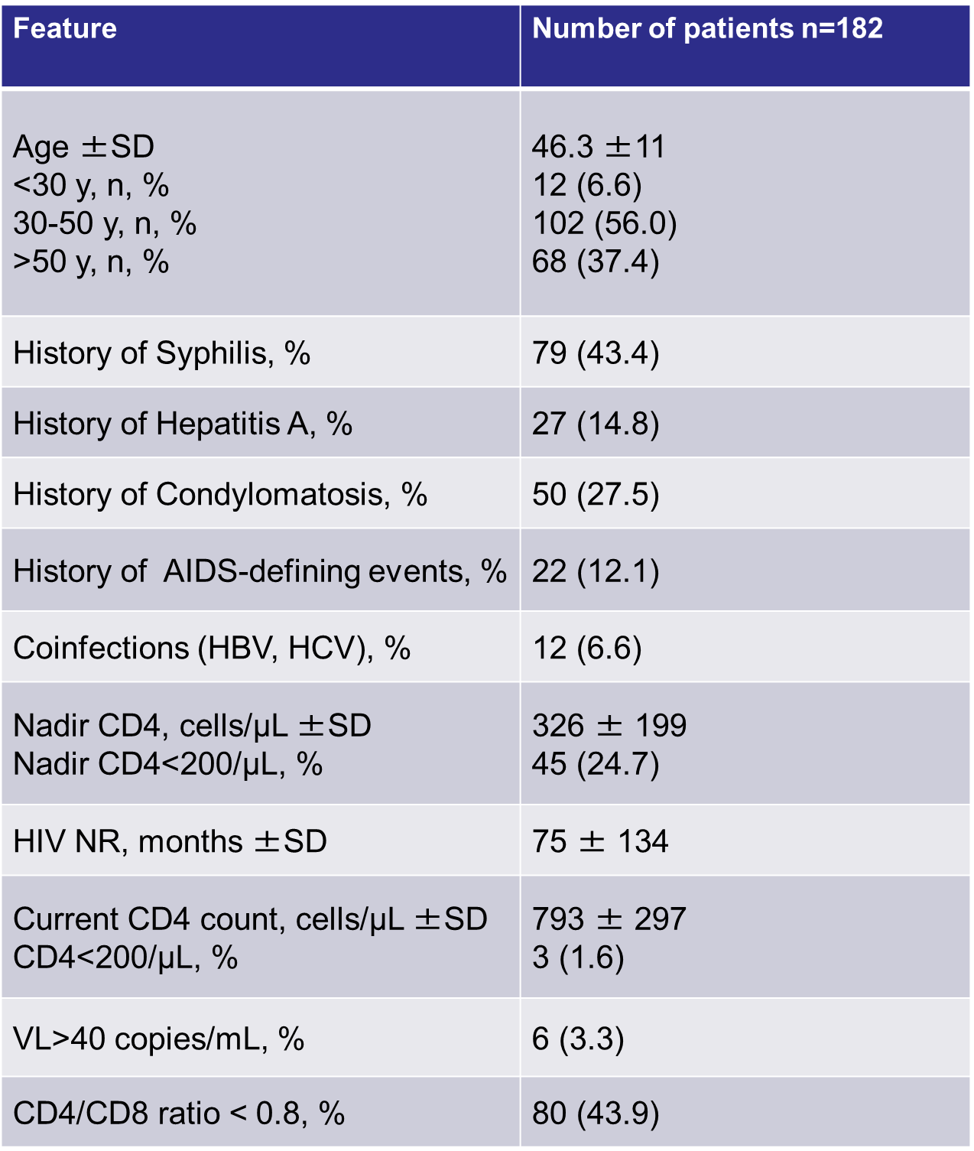
Results: 182 patients enrolled
Patients enrolled were aged between 30 and 50 years
Viro immunological paramethers show an optimal HIV control in the majority of cases

Slide 9
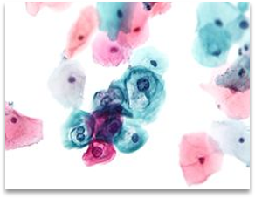
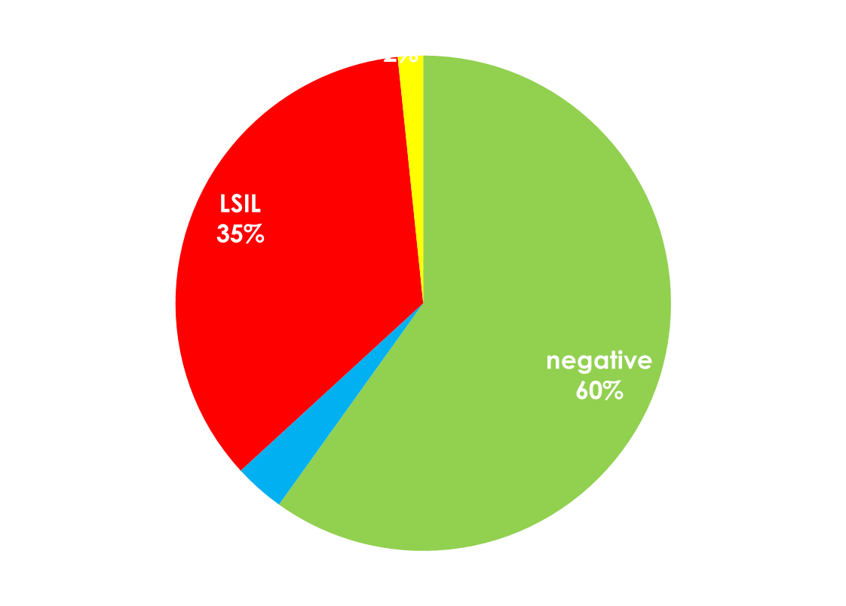
Pap test results
67 (37 %) were positive for HPV related lesions, 64 (35 %) low grade squamous intra-epithelial lesions (LSIL) and high grade lesions (HSIL) were found in 3 patients (2 %)

Slide 10
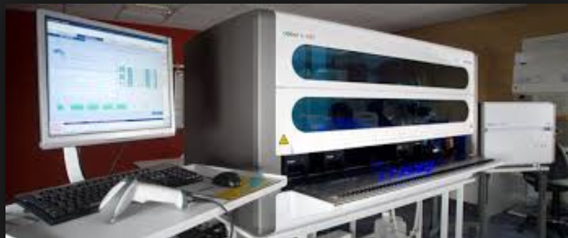
HPV genotyping results
129 of 182 screened (70,9%) performed also HPV genotyping: 4 resulted negative, 11 low risk HPV genotype carriers (LRHPV), 13 probable high-risk HPV carriers (pHRHPV), 101 high risk HPV (HRHPV) genotype carriers.
We don’t have genotype of 29% of screened patients since PCR implementation was obtained 6 months after first Pap tests.

Slide 11
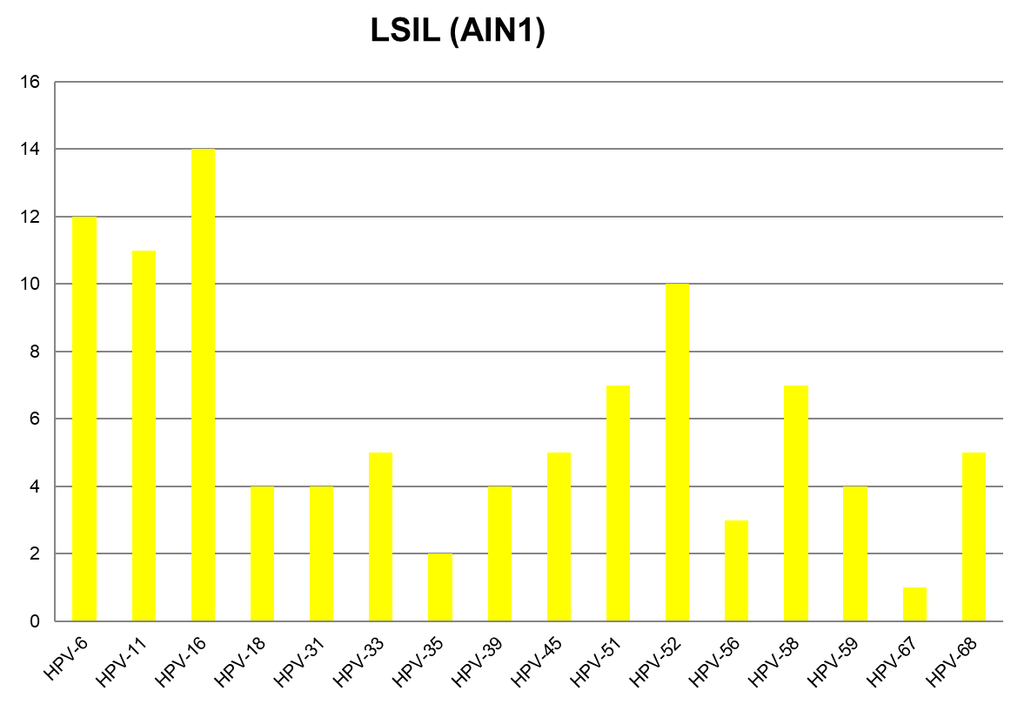
HPV genotyping results
HPV16 was found in 30 patients (18,3%) and it was the most frequently identified high risk genotype followed by HPV 52 (27 patients, 20,9%) and HPV 51 (21 patients, 16,3%). HPV18 was found in 17 patients (13,2%).
In 62 cases out of 129 there were three to more HPV genotypes, in 59 of these cases there was at least one high-risk genotype.

Slide 12
HPV genotyping results
Only 35 HRHPV carriers (34,7%) had a positive citology.
66 (65,4%) HRHPV carriers resulted Pap test negative or presented ASCUS, they resulted anoscopy eligible only for hosting high risk genotype
Among non HRHPV carriers, 42,9% were Pap test positive, all presenting LSIL.

Slide 13
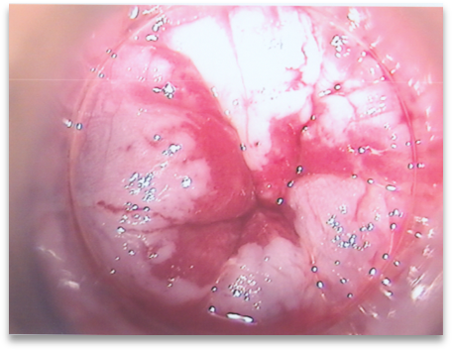
HRA results
A total of 133 screened (73,1%) had the indication for HRA (67 positive Pap tests plus 66 HRHPV with negative cytology or ASCUS).
Among 64 biopsies performed until today (53 in Pap test + and 11 in HRHPV carriers), 27 showed LSIL, 9 HSIL and one carcinoma in situ.

Slide 14
HRA results
3 HSILs were found in HRHPV carriers with negative Pap test, 6 in Pap test positive. HRA confirmed cytology in 28 cases, showed a worsening in 13 cases and a lower grade lesion or no more lesions in 23 cases.
 | HRA NEG (27) | HRA LSIL (27) | HRA HSIL (9) | HRA CIS (1)
Pap test Neg HRHPV + (11) | 4 | 4 | 3 | 0
Pap test LSIL (52) | 23 | 23 | 5 | 1
Pap test HSIL (1) | 0 | 0 | 1 | 0

Slide 15
Lesions evolution
HRA results – lesions evolution
Among 8 patients in which HRA was repeated in 4 months, 3 cases of clinical progression were detected: 1 with HRHPV but negative cytology became L-SIL, 1 L-SIL became H-SIL and 1 carcinoma in situ was found in a patient treated for H-SIL four months before.
Pap test – HRHPV +
4 months
Second HRA: L-SIL
4 months
Second HRA: H-SIL
First HRA: H-SIL
DTC + 1 mt
Second HRA: CIS
First HRA: negative
First HRA: L-SIL

Slide 16
Limits
Few data on Pap test follow up currently available
Small sample size, no women included
No data on number of sexual partners and smoking habits

Slide 17
Conclusions
Our results show similar rates of HPV-related lesions and of HRA eligibility rate to those reported in literature^{1,2}
HPV-related dysplasia is common among HIV+ MSM and is likely to evolve in a short period of time especially in the presence of high-risk genotypes.
We have not found any correlation between screening results and clinical and viro-immunological paramethers studied
We recommend the association of HPV genotyping with cytology as first level of screening and HRA for treatment and follow up of lesions as this bundle allows to identify lesions in subjects with a negative Pap-test.
HPV related lesions (L-SIL and H-SIL) | 37%
HRHPV carriers | 56%
HRA indication | 73,10%
¹Iribarren-Diaz M, Ocampo-Hermida A et al. Preliminary results of a screening program for anal cancer and its precursors for HIV-infected men who have sex with men in Vigo-Spain. Rev Esp Enferm Dig 2017;109(4):242-249
² Hidalgo-Tentorio et al. Risk factors for infection by oncogenic human papillomaviruses in HIV-positive MSM patients in the ART era (2010-2016). Medicine 2017 96:39

Slide 18

Acknowledgements
Infectious Diseases Clinic Policlinico di Modena
Prof. Cristina Mussini
Carlotta Rogati
Microbiology Laboratory of the Department of Diagnostic, Clinical and Public Health Medicine
Monica Pecorari
Complex Structure of General Emergency and Oncological Surgery
Prof. Roberta Gelmini
Prof. Alberto Farinetti
Francesco Spatafora
Proctological Surgery Unit
Nuovo ospedale civile di Sassuolo (MO)
Roberto Paolo Iachetta
Roberto Dino Villani

